Slide 1
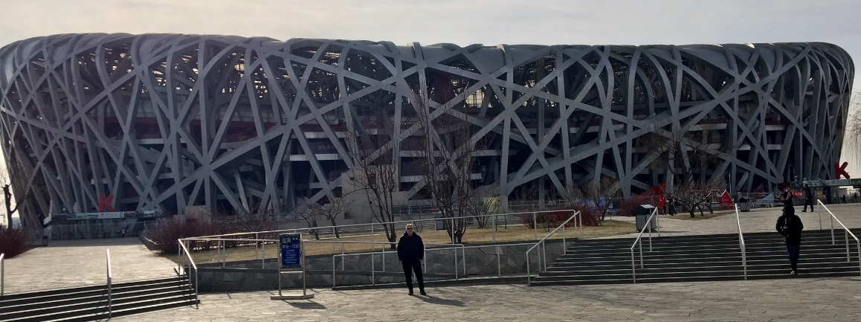
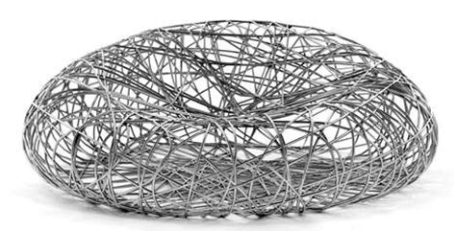
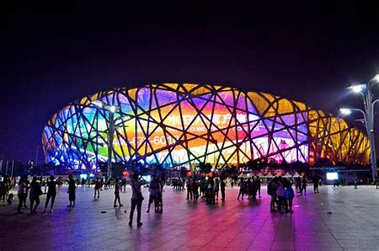
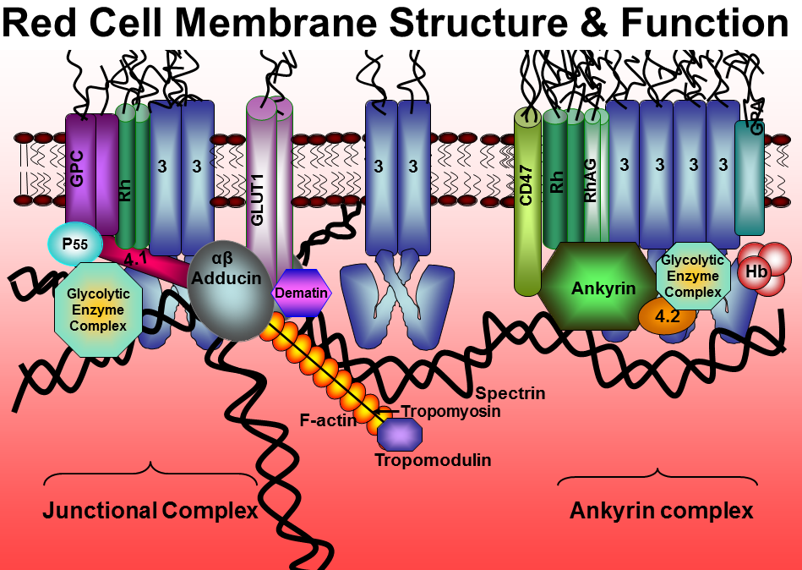
Olympic Stadium “Bird Nest’ Beijing 2008
Red blood cell cytoskeleton

Slide 2
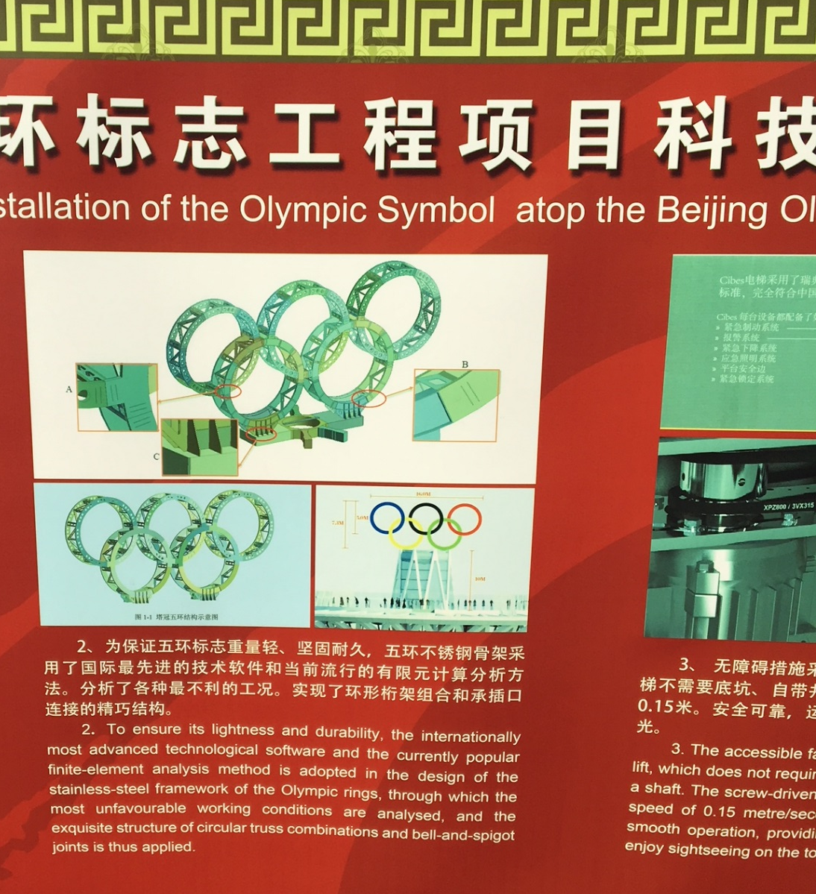
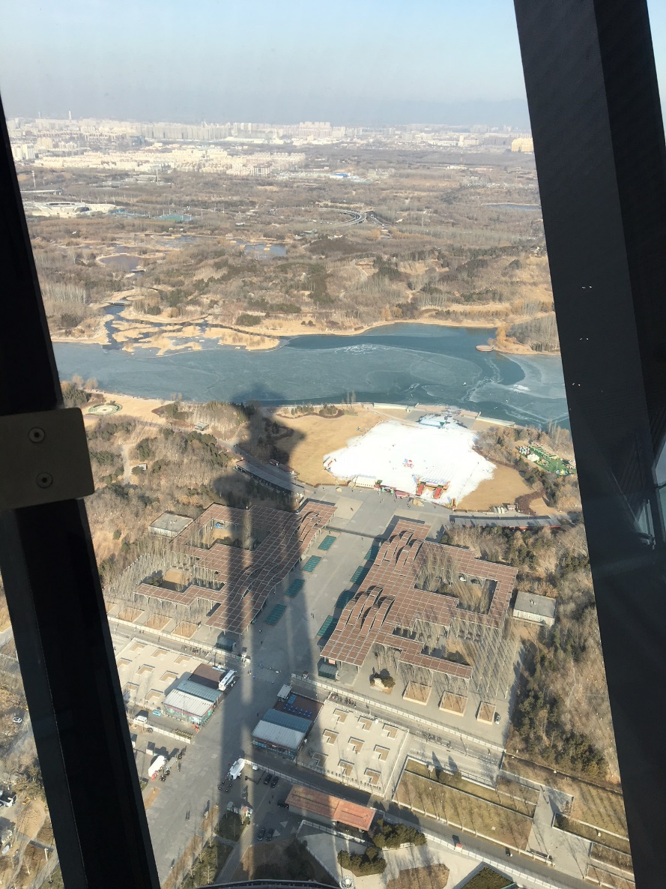
Top of the Olympic Tower

Slide 3
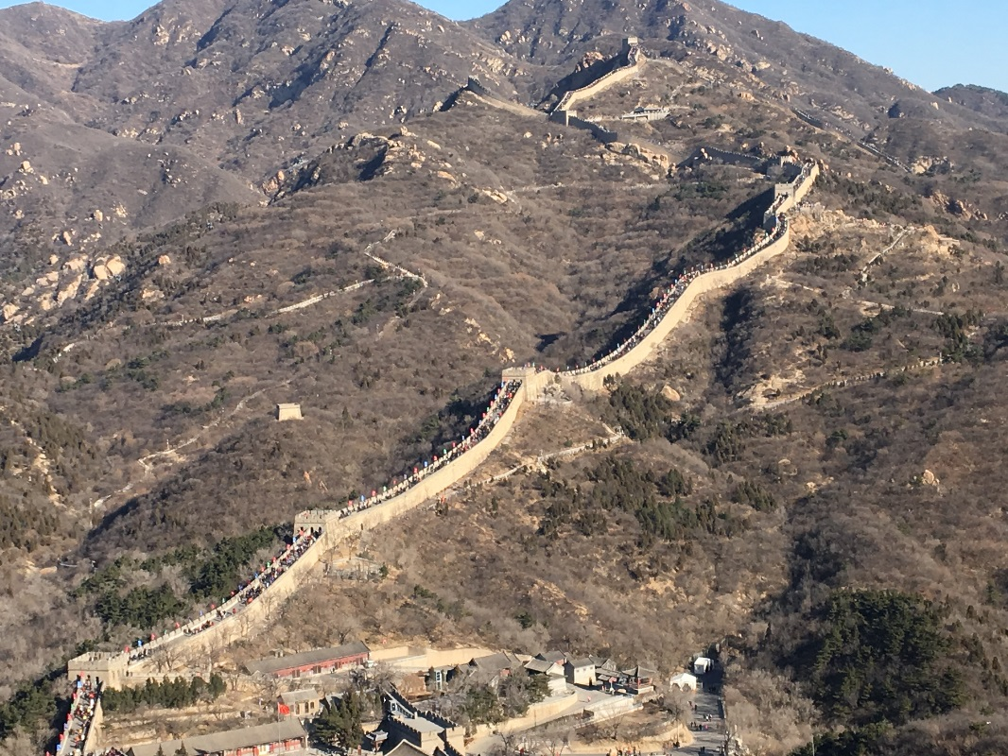
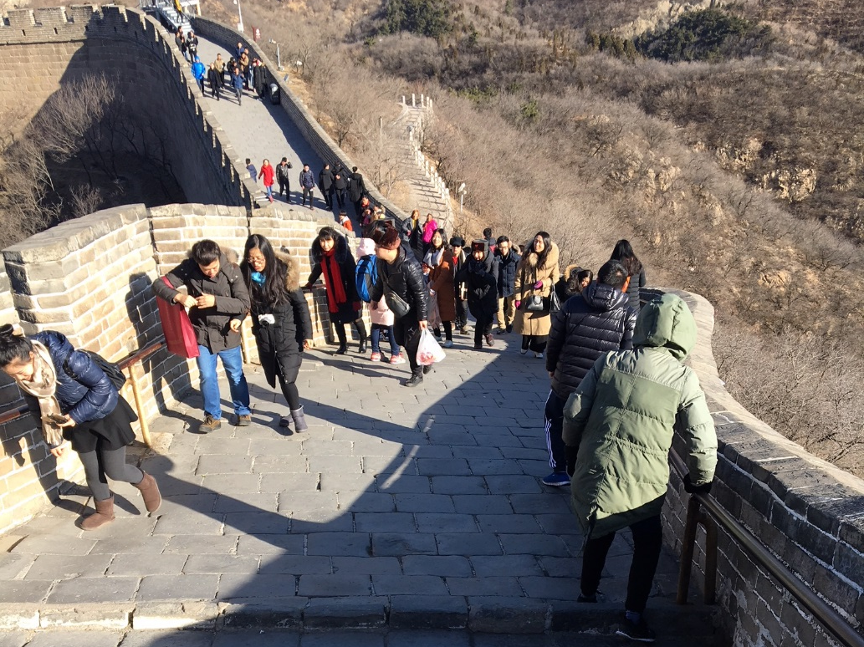
Concept of “Gradient”
China Great Walls
Going up
Going down
Fourier Law
1D- Flow
Going down “negative” gradient
Going up “positive” gradient
3D- Flow

Slide 4
Lecture 3
Objectives
Example Problems – Steady State Heat Transfer
Steady State Heat with Heat Generation
Steady-State Heat Transfer for Extended Surfaces

Slide 5
Steady State Heat with Heat Generation
Useful Concepts to study and gain an understanding
on thermoregulation phenomenon.
Thermoregulation: It is based on maintaining a constant
temperature in time biologically. So steady state
heat transfer can describe it.
Active process
In “warm” blood animals, temperature is maintained,
despite changes in environmental and internal conditions,
for instance by sweating or changes in heat resistance.
Passive process
In “cold” blood animals (fish), the steady state “body”
temperature changes as a consequence of changes
in environmental or internal conditions

Slide 6
Thermoregulation
Warm blood animals (e.g. human beings)
to cool down, these mechanisms include:
Sweating: Sweat glands release sweat, which cools the skin as it evaporates. This helps lower your internal temperature.
Vasodilatation: The blood vessels under your skin get wider. This increases blood flow to the skin, which is cooler — away from your warm inner body. This lets your body release heat through heat convention and radiation.
to warm up, mechanisms include:
Vasoconstriction: The blood vessels under your skin become narrower. This decreases blood flow to your skin, retaining heat near the warm inner body.
Thermogenesis: Your body’s muscles, organs, and brain produce heat in a variety of ways. For example, muscles can produce heat by shivering.
Hormonal thermogenesis: Your thyroid gland releases hormones to increase your metabolism. This increases the energy your body creates and the amount of heat it produces.

Slide 7
Thermoregulation
18ºC
34ºC
4000 kg
4.65 kW of heat dissipation

Slide 8
Steady State Heat with Heat Generation – 1D heat transfer
y
x
A
Assume
T₁
Steady State
T₁
1D heat flow (x-direction)
Know temperatures in boundaries
x=-L
x=L
x=0
An extra boundary condition,
kind of “virtual/created
but realistic!!!

Slide 9
Steady State Heat with Heat Generation
Temperature Profile T(x)
x
x=-L
x=0
x=L
Under Steady State the Heat Flow through one of the surfaces is equal to the heat generated in half of the slab. Symetric problem

Slide 10

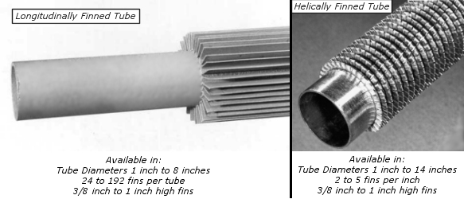
Steady-State heat Transfer for Extended Surfaces
Surfaces of small cross-sectional area
They improve heat transfer
Widely used for heating and cooling. For calculations assume 1D heat conduction along the length of the fins and heat flow in or out of the fin by convection trough a fluid in contact to the fin
Finned Tubes

Slide 11
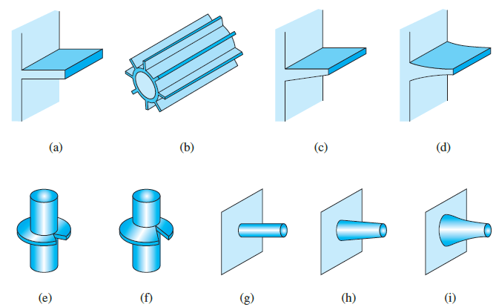
Different Types of Fins

Slide 12
Different Types of Fins
Types of Fin designs are “MANY”
Choice is by
Cost
Weight
Available space
Fluid pressure drop

Slide 13
Steady-State heat Transfer for Extended Surfaces
Convection
Dividing the equation by
and kA_{c}
and for
Convection
Convection
and
A_{c}
P: Perimeter

Slide 14
Steady-State heat Transfer for Extended Surfaces
Solution

Slide 15
Steady-State Heat Transfer for Extended Surfaces
Effectiveness
No-Finned Surface
Finned Surface
Convection
Convection
Convection
Convection
A_{c}
A_{c}

